Slide 1

NI SLAG VALORISATION IN INDONESIA:
A CASE STUDY
Sotya ASTUTININGSIH, Bambang SUHARNO
Department of Metallurgical and Material Engineering, Faculty of Engineering, Universitas Indonesia, Kampus UI, 16424 Depok, Indonesia

Slide 2




GAMBARAN INDUSTRI NIKEL
INDUSTRIAL PICTURE
INDUSTRIAL SECTOR
NICKEL ORES
TRANSPORTATION
Deposit: No. 6 in the world
Resources: 3 billion ton
Cadangan : 1 milyar ton
Production No. 2 in the world(2011).
AUTOMOTIVE
Consumption: 100.000 tpy
Growth 12% py
HOUSEHOLD APPLIANCES
METALS
Growth : 10% py
Ferro Nickel production : 180,000 Ton
Domestic consumption (stainless steel) : 150,000 Ton
98% Ferro Nickel production supplied for domestic consumption
MEDICAL DEVICES
INTERMEDIATE & DOWNSTREAM PRODUCTS
Simple tools that requires sterilisation
Growth 10% py
Export 7.200 ton
Import 1.200 ton (2012)
CONSUMPTION PER CAPITA
Stainless Steel: 0.6 kg
Target : 1.5 kg (2025)
Source: DIREKTORAT INDUSTRI LOGAM
DITJEN INDUSTRI LOGAM MESIN ALAT TRANSPORTASI DAN ELEKTRONIKA
MINISTRY OF INDUSTRY
Notes:
Excelnya belum ada;
Masih pure ngopy dari Ppt (pak Soemantri)
untuk penambahan nilai tambah dalam rangka ekspor

Slide 3
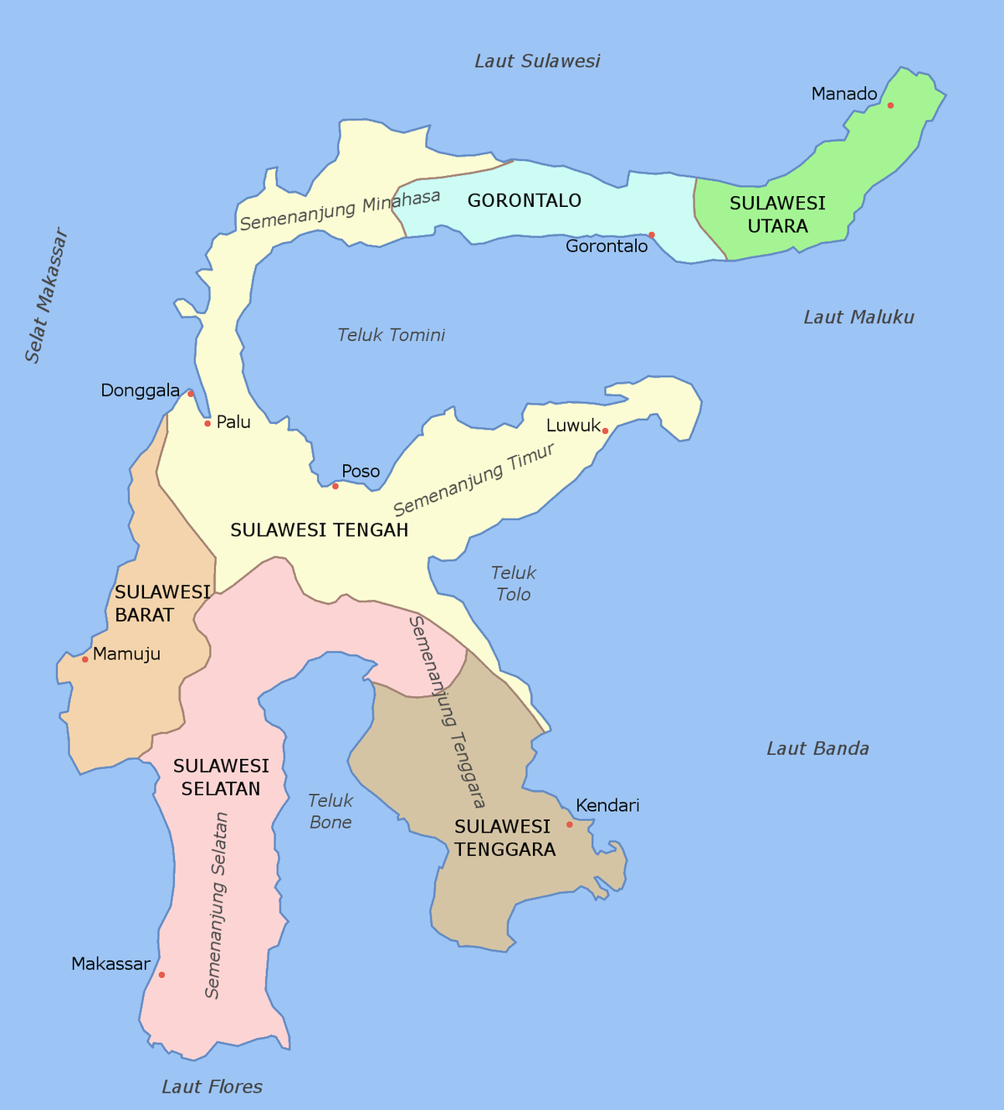
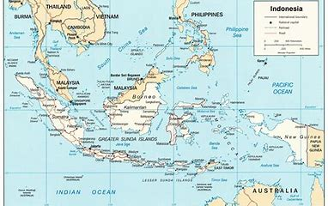

Slide 4
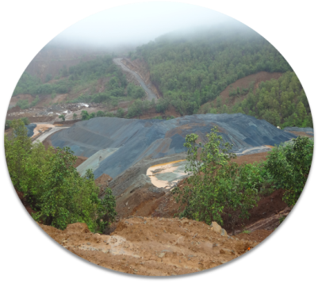
Nickel slag production per year
in some of ferronickel industry,
Currently 15 smelters have been operating
No | Company name | Ni sla g produced
 |  | Tonnes/year
1 | PT Trimegah Bangun Persada (PT TBP) | 1.000.000
2 | PT Aneka Tambang (PT Antam,Tbk) | 1.000.000
3 | PT Indonesia Morowali Industrial Park (PT IMIP) | 7.000.000
4 | PT Virtue Dragon Indonesia (PT VDI) | 4.000.000
Creation in Added Value

Slide 5
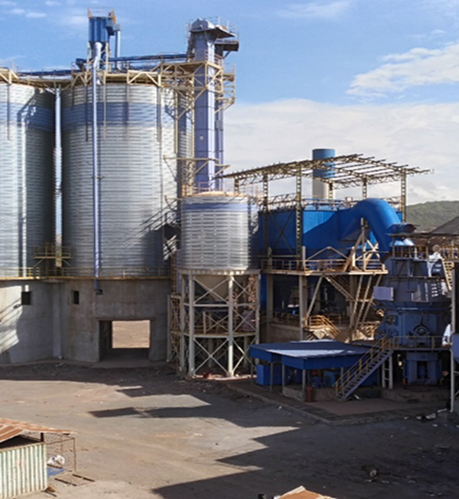
GROWTH JAVA INDUSTRY
Slag used throughout this experiment was ground granulated blast furnace slag (GGBFS) supplied by one of Ni smelting industries in Indonesia.
This company produced 360,000 TPY ground granulated blast furnace slag (GGBFS) and 300,000 TPY of slag from electric furnace.
This company is 1 of 15 Ni smelters operating in Indonesia
They already obtained a government permit for GGBFS valorisation, however, only 10% of the capacity is consumed.
Consumers of this GGBFS includes Portland cement industry, ready-mix concrete, precast concrete, and mortar industry.
To increase the consumption, GGBFS will be used as the main solid precursor for inorganic polymer.

Slide 6
Slag characterization

Slide 7
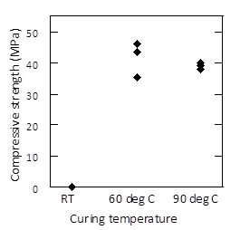
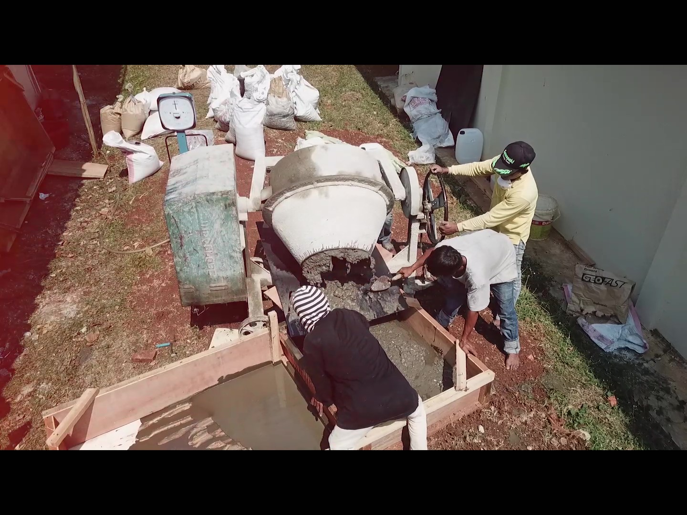
Geopolymerisation of Ni GGBFS
Figure 3: Compressive strength of geopolymer mortar cured for 24 hours
Geopolymer mortar was prepared by mixing GGBFS, quartz sand, and sodium silicate solution. The solution was made from technical grade NaOH, water glass and water. The solution to the powder, i.e. GGBFS and quartz sand, ratio was ~0.33.

Slide 8
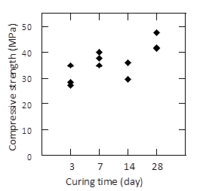
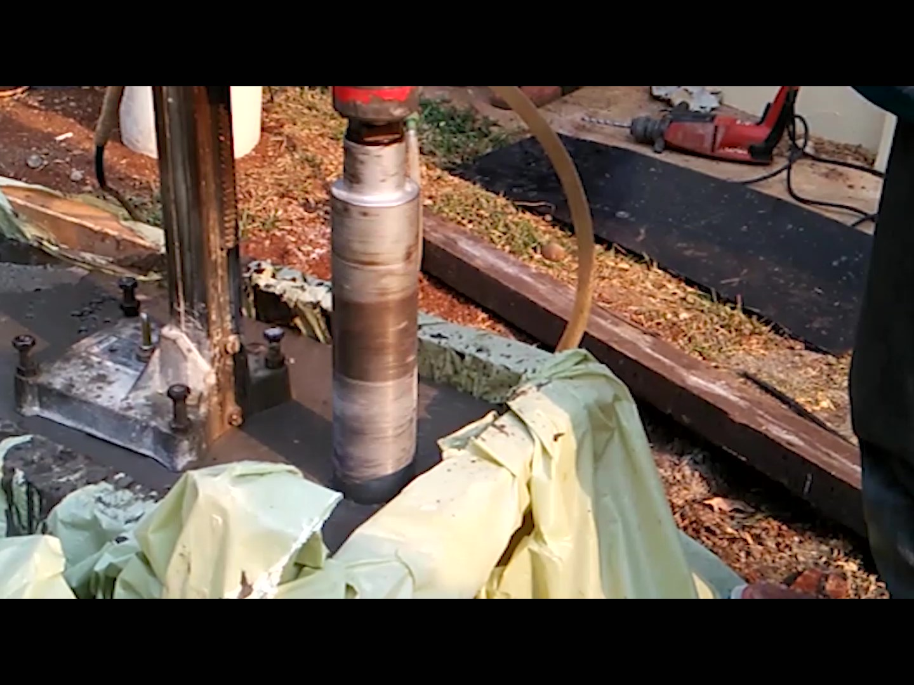
Figure 4: Compressive strength of geopolymer concrete cured at room temperature
The composition of the concrete was approximate, in wt%, 35 coral; 22 quartz sand, 27 GGBFS, and 16 sodium silicate solution

Slide 9
Conclusion
GGBFS from nickel smelting has the potential to be utilized as building materials. Compressive strength of both the geopolymer mortar and concrete were sufficient for use as building materials.
The consumption of GGBFS for inorganic polymer is significantly higher than as Portland cement substitutes.
The challenge is more to the vast amount of the slag and the supply chain (logistic) of the raw materials to the users.
Most of the smelters are located in the island with less population and needs less infrastructure.
THANK YOU
For your attention

